Slide 1
Force of Mercury
SolarProx

Slide 2
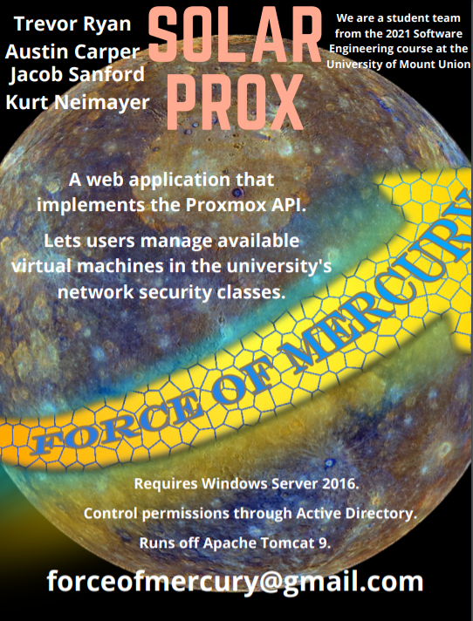
Trevor Ryan - Team Leader
Jacob Sanford - Lead Architect
Kurt Neimayer - Lead Tester
Austin Carper - Configurations Manager
Ken Smith - Client

Slide 3
The Problem

Slide 4
Students in network security classes have to wait for admin to revert machines if a machine goes down
No point system available to students
Sometimes the admin is busy and the machine can’t get reverted for a while
Integrate shared login between Proxmox and VPN’s active directory login

Slide 5
Solution

Slide 6
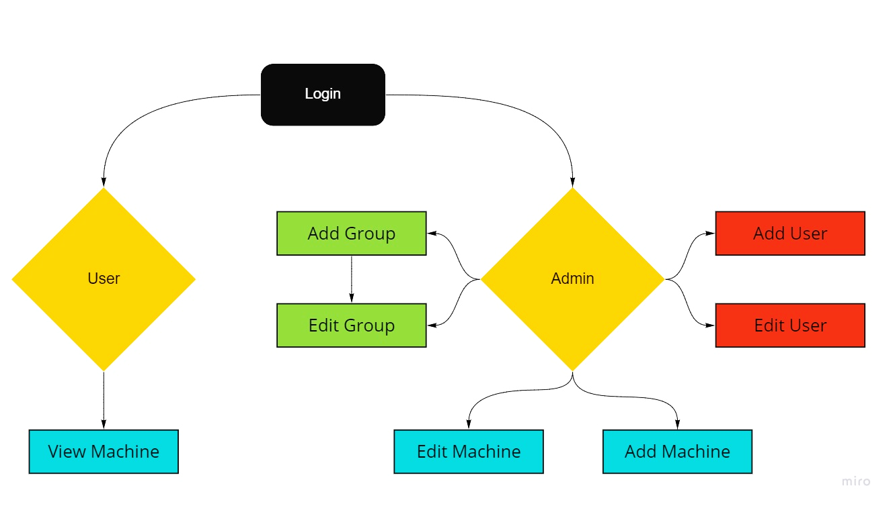
Build a web application that allows students to access active machines and revert them when they go down
Create a connection between the web application and Proxmox
Allow students to enter flag values for machines to get points for completing the machine

Slide 7
Features

Slide 8
Login page for the users to login to with stored credentials
List of active machines for users
List of all machines for the admin
Different user and admin views based on permissions set in Active Directory

Slide 9
Notes set on machine by the admin
Admin can set what machines are active
Field to enter flag values for machines which gives points to that user’s account
Targeted towards students in Mount Union’s network security classes as well as the administrator to control access and manage machines
Users will have a basic understanding of how Proxmox works to revert machines while the administrator will have a high understanding on how Proxmox works

Slide 10
Software Development Tools

Slide 11
Jetbrain’s IntelliJ
Github
Proxmox
Windows Server 2016
Apache Tomcat Server 9
Maven
OpenVPN

Slide 12
Programming Languages

Slide 13
Java
HTML5 Suite (CSS/HTML/JavaScript)

Slide 14
User Interface Libraries

Slide 15
Apache Tomcat 9
Bootstrap

Slide 16
Documentation Schedule

Slide 17
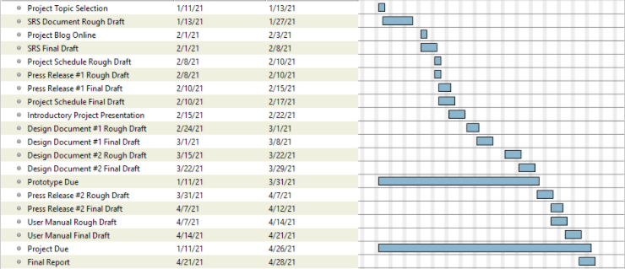

Slide 18
Project Schedule

Slide 19
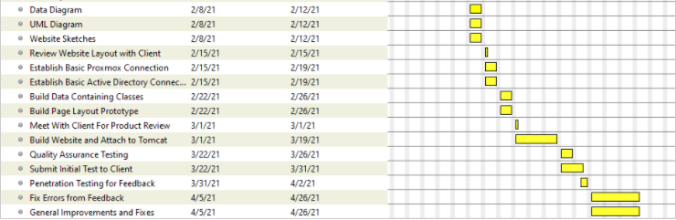

Slide 20
Campus Computing Resources

Slide 21
Silver
Ken Smith’s virtual lab environment

Slide 22
Configuration Management

Slide 23
Github Branches for management with rules
2 User approve to merge branch
Kanban Board to prevent workload confusion

Slide 24
Force of Mercury Blog Page

